Slide 1
Multiway Trees

Slide 2
M-way Search Trees
M-way Search Trees
Is a search tree in which each node can have from 0 to m subtrees, where m is defined as the B-tree order
A nonempty multiway tree, we can identify the following properties:
Each node has 0 to m subtree
A node with k < m subtrees contains k subtrees and k-1 data entries
The key values in the first subtree are all less than the key value in the first entry; the key values in the other subtrees are all greater than or equal to the key value in their parent entry
The keys of the data entries are ordered
All subtrees are themselves multiway trees
Binary tree is an m-way tree of order 2

Slide 3
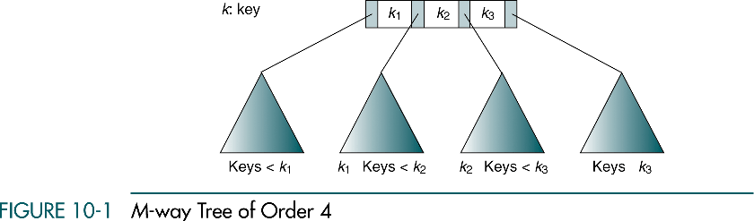

$$≤$$
$$≤$$
$$≤$$
Keys

Slide 4
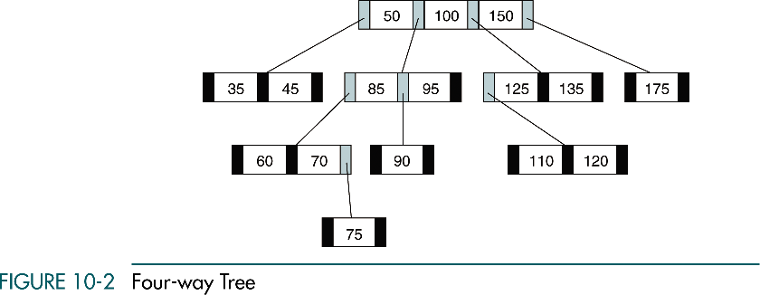

Slide 5
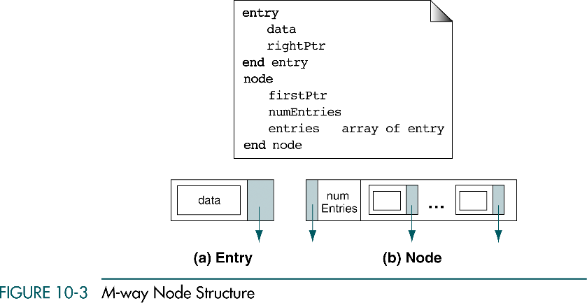

Slide 6
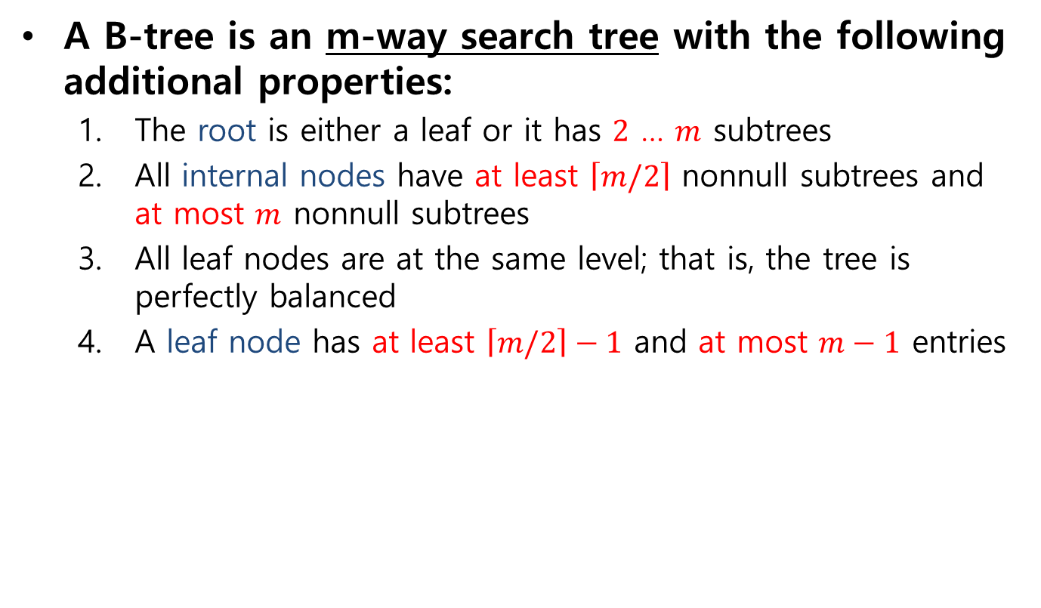
B-trees
A B-tree is an m-way search tree with the following additional properties:
The root is either a leaf or it has $2$ … $m$ subtrees
All internal nodes have at least $\left\lceil m/2\right\rceil$ nonnull subtrees and at most $m$ nonnull subtrees
All leaf nodes are at the same level; that is, the tree is perfectly balanced
A leaf node has at least $\left\lceil m/2\right\rceil −1$ and at most $m−1$ entries

Slide 7
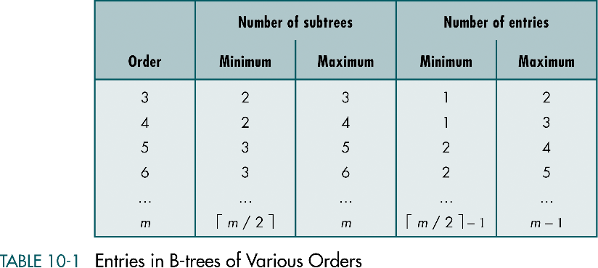

Slide 8
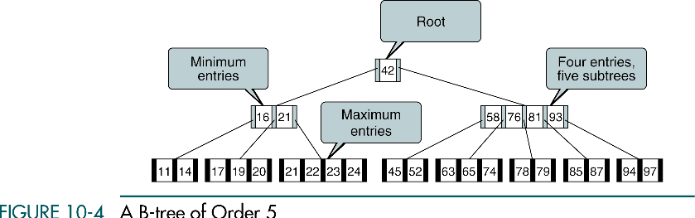

Slide 9
B-tree Implementation
Four basic operations for B-trees
Insert
Delete
Traverse
Search

Slide 10
B-tree Insertion
B-tree insertion takes place at a leaf node
The first step is to locate the leaf node for the data being inserted
If the node is not full (if it has fewer than m-1 entries), the new data are simply inserted
When the leaf node is full, we have an overflow condition
Overflow requires that the leaf node be split into two nodes, each containing half of the data
To split the node, we allocate a new node from the available memory and then copy the data from the end of the full node to the new node
The new entry is inserted into either the original or the new node, depending on its key value
The median data entry is inserted into the parent node

Slide 11
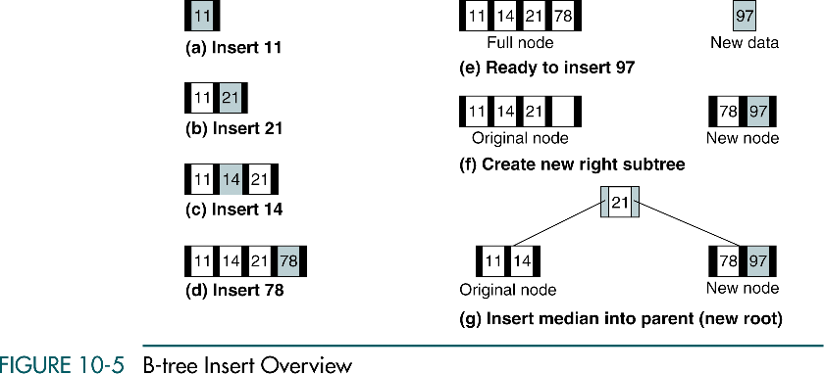
(Order 5)

Slide 12
B-tree Insertion
Binary search trees
Grow in an unbalanced fashion from the top down
B-trees
Grow in a balanced fashion from the bottom up
When the root node of a B-tree overflows and the median entry is pushed up, a new root node is created and the tree grows one level

Slide 13
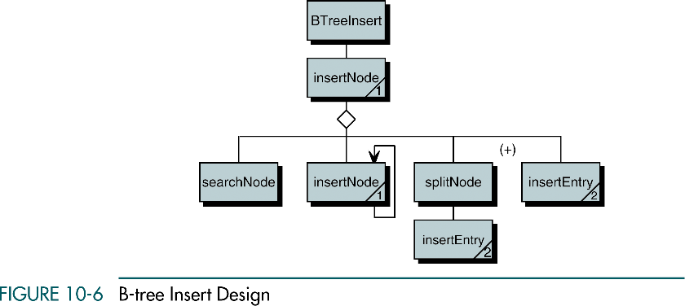

Slide 14
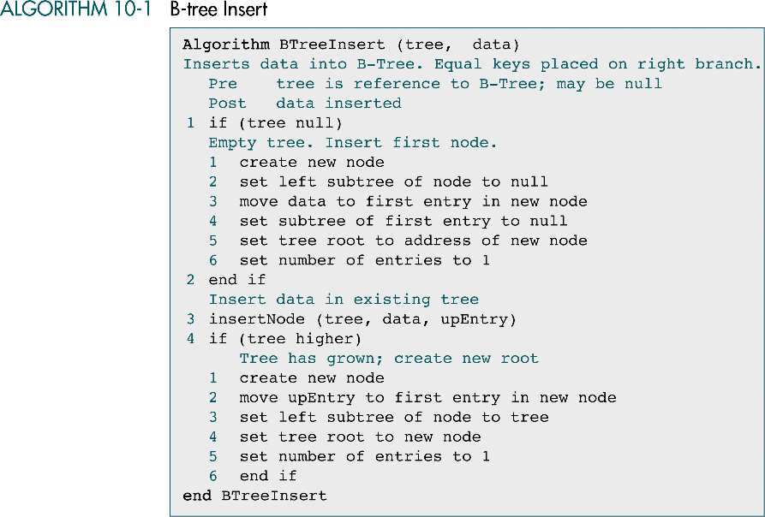

Slide 15
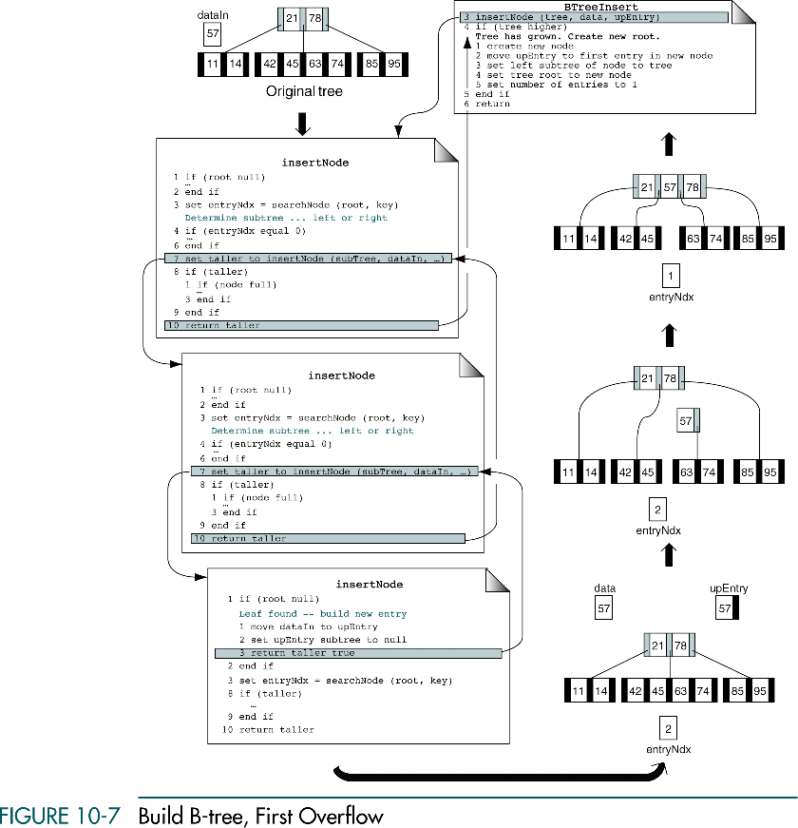

Slide 16
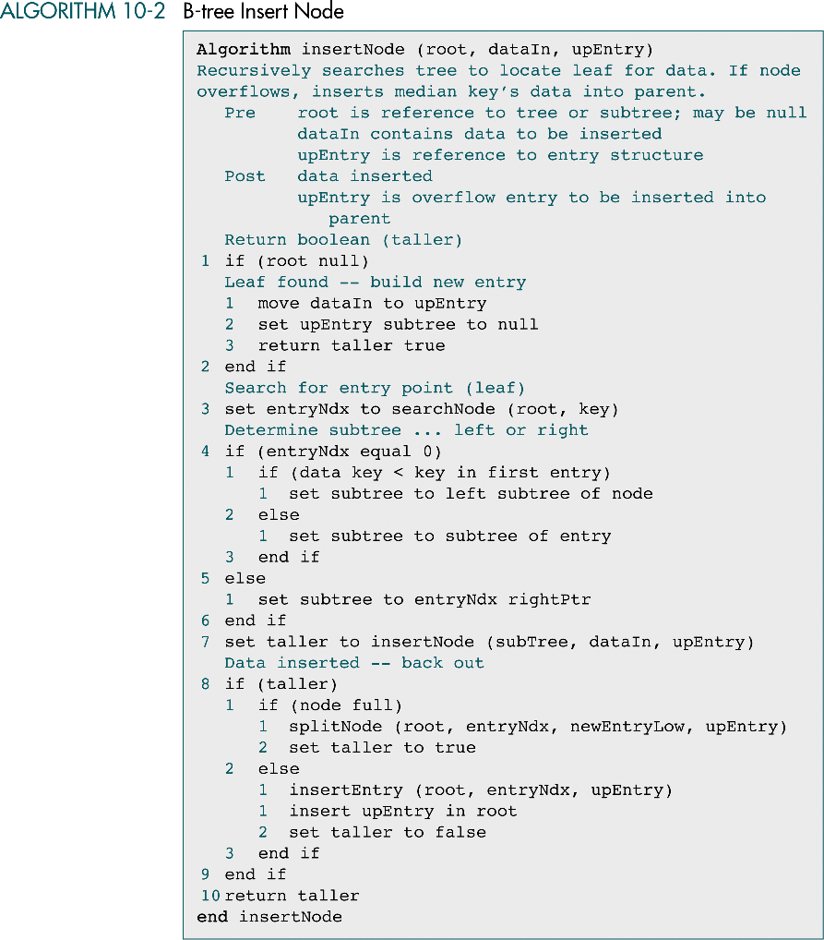

Slide 17
(continued)
insert upEntry in root

Slide 18
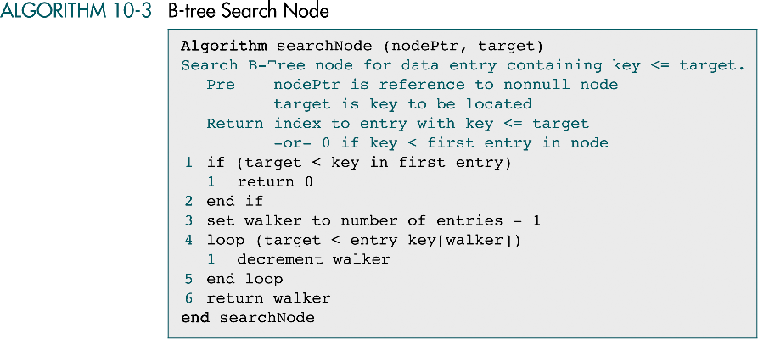

Slide 19
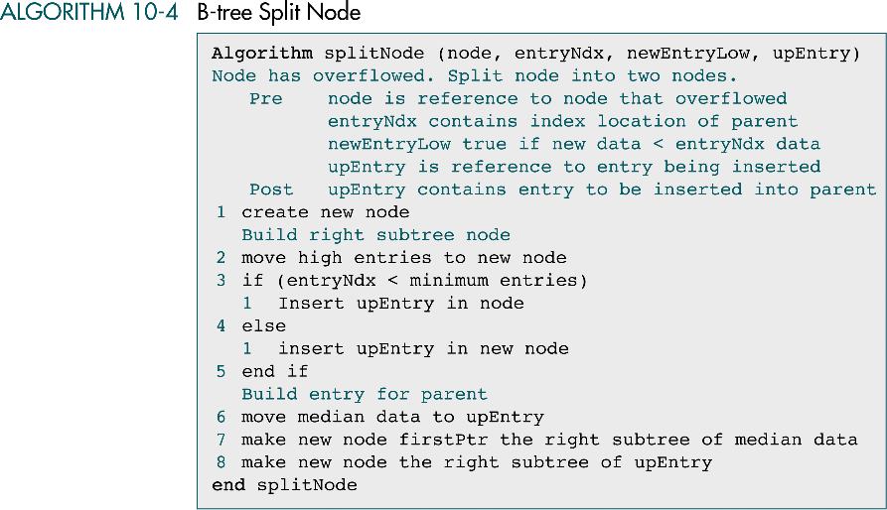
median

Slide 20
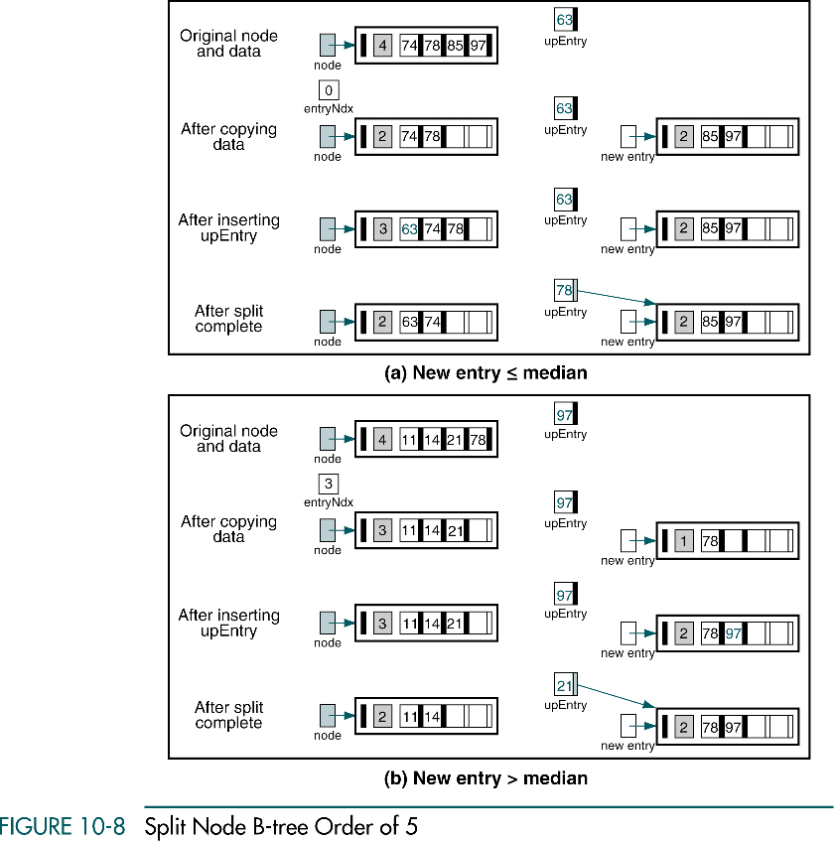

Slide 21
(continued)

Slide 22
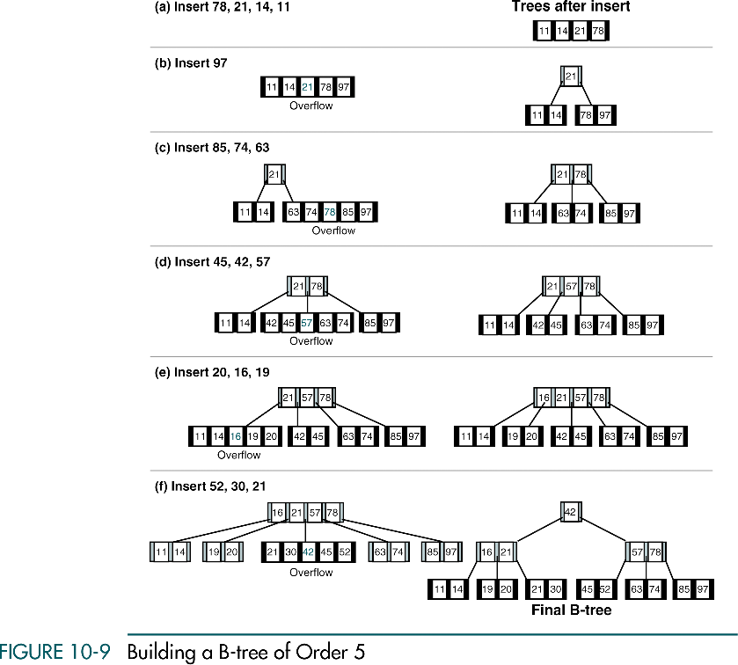

Slide 23
(continued)

Slide 24
B-tree Deletion
There are three considerations when deleting a data entry from a B-tree:
We must ensure that the data to be deleted are actually in the tree
If the node does not have enough entries after the deletion, we need to correct the structural deficiency
Underflow : a node with fewer than the minimum number of entries
If the data to be deleted are in an internal node, we must find a data entry to take their place

Slide 25
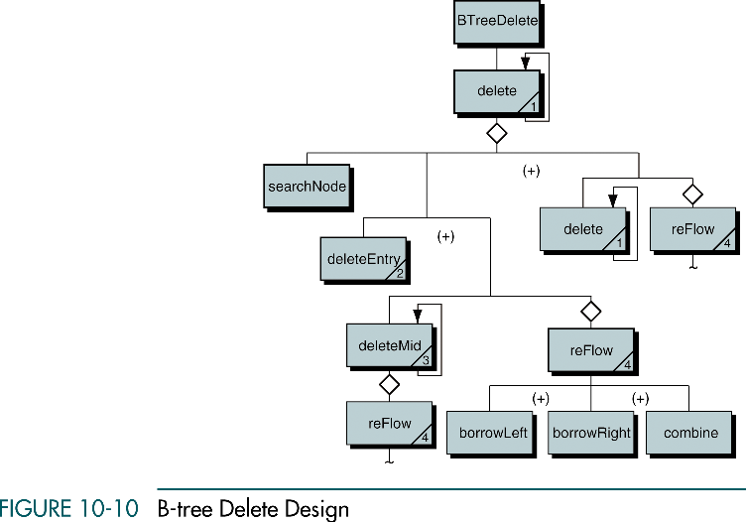
Searches for the data to be deleted

Slide 26
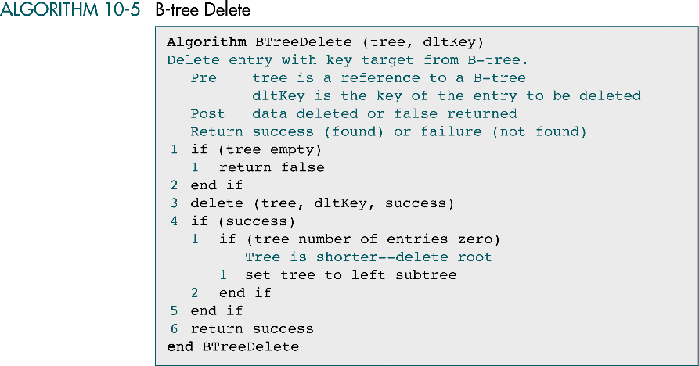
Checks for root underflow

Slide 27
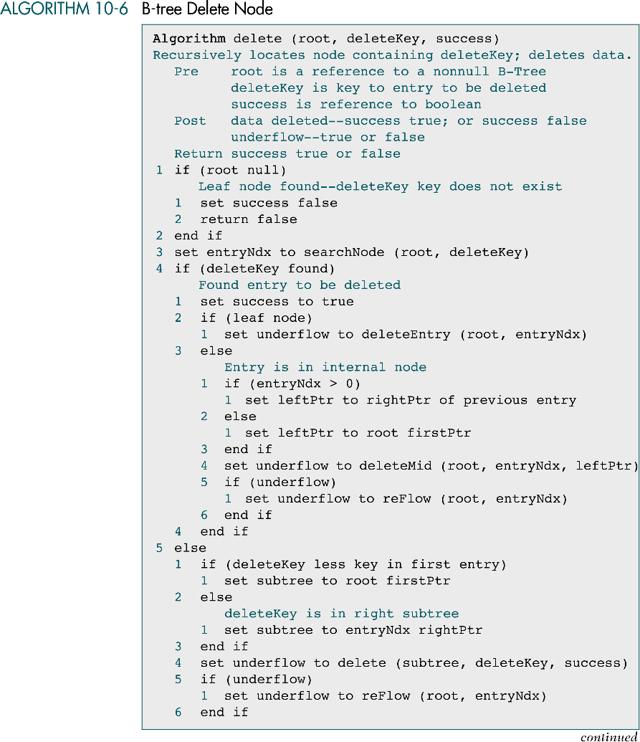

Slide 28

(continued)

Slide 29
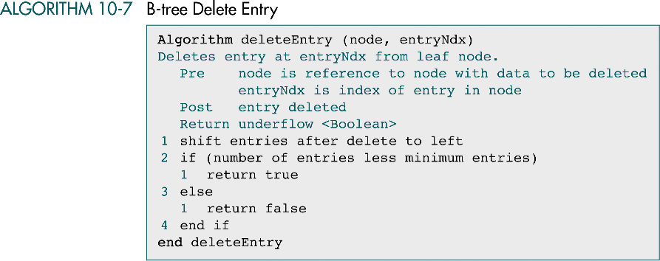

Slide 30
Delete Mid
All deletions must take place at a leaf node
When the data to be deleted are not in a leaf node, we must find substitute data
Two choices for substitute data: the immediate predecessor or the immediate successor
The former is more efficient because no shifting is required when it is deleted
the immediate predecessor is the largest node on the left subtree of the data to be deleted

Slide 31
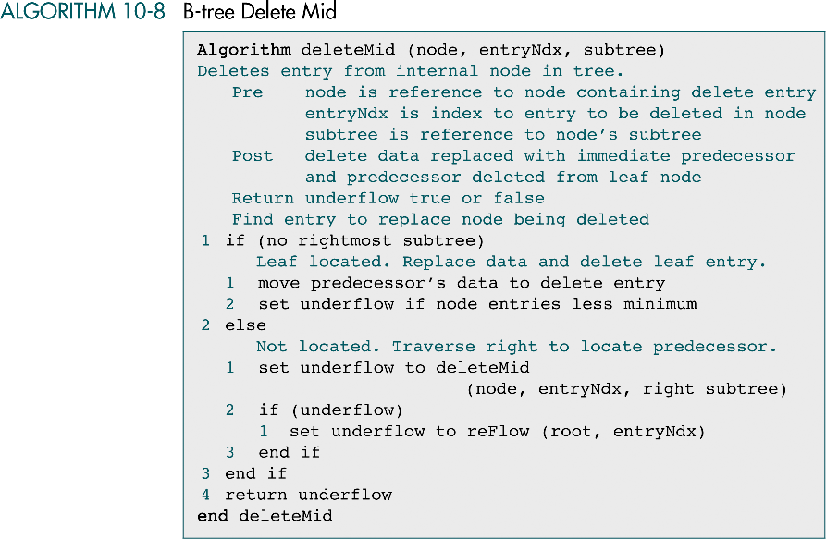

Slide 32
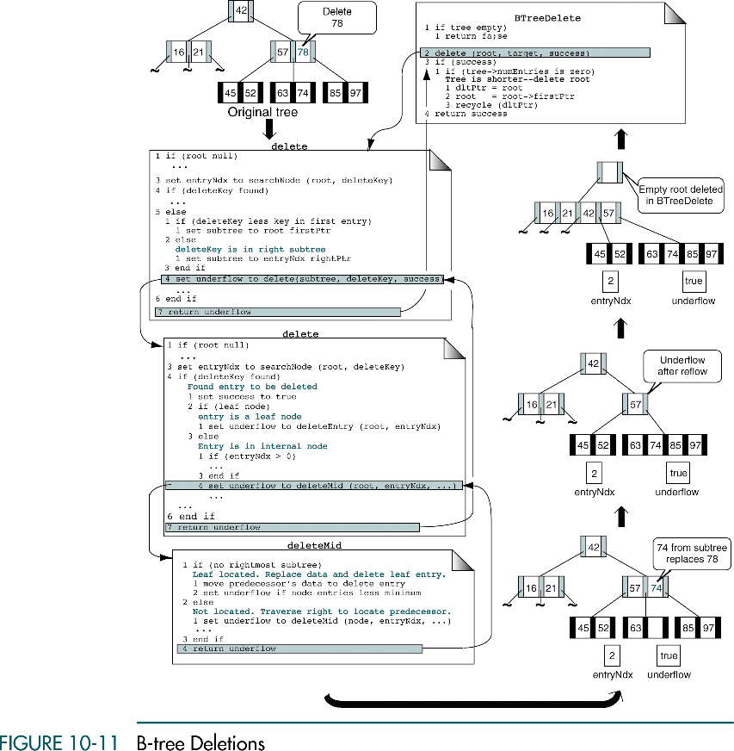

Slide 33
Reflow
Reflow
When underflow has occurred, we need to bring the underflowed node up to a minimum state by adding at least one entry to it
Two concepts
Balance shifts data among nodes to reestablish the integrity of the tree (it does not change the structure of the tree)
Combine joins the data from an underflowed entry, a minimal sibling, and a parent in one node → results in one node with the maximum number of entries and an empty node that must be recycled

Slide 34
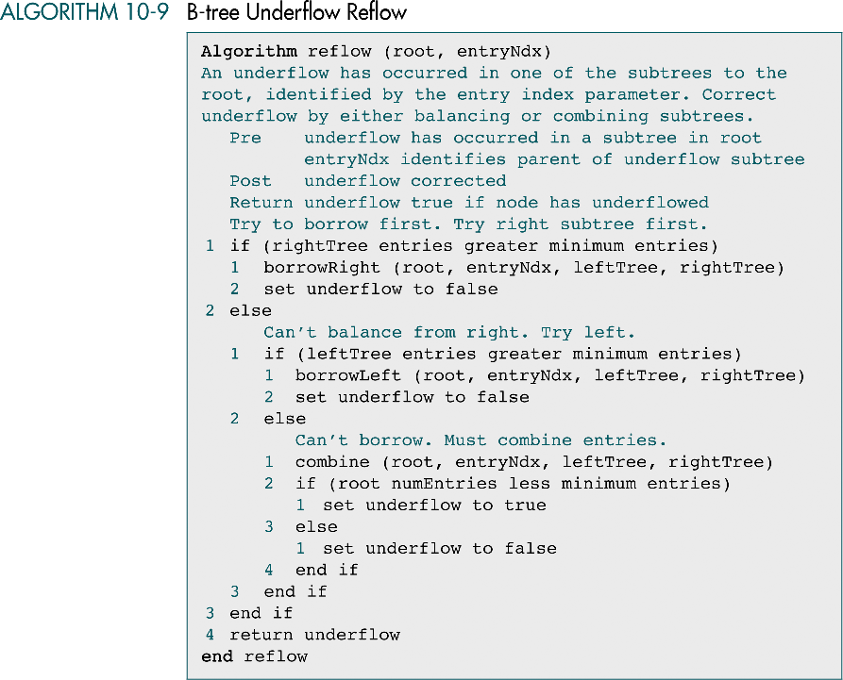

Slide 35
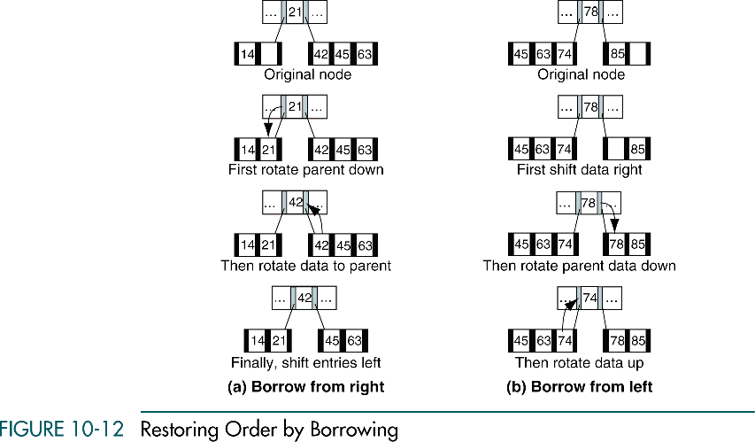

Slide 36
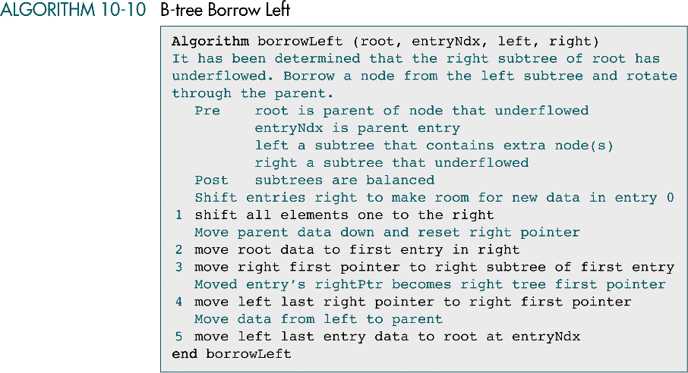

Slide 37
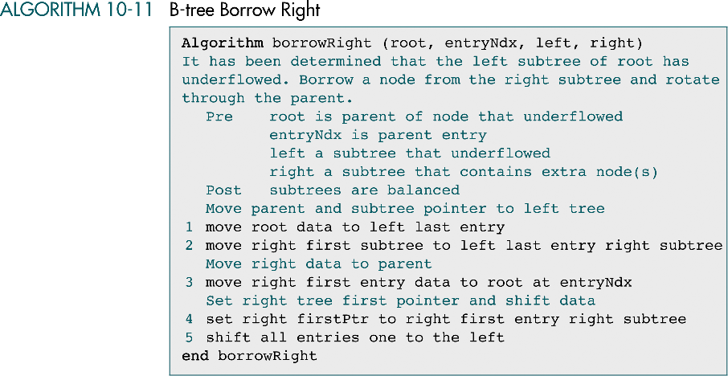

Slide 38
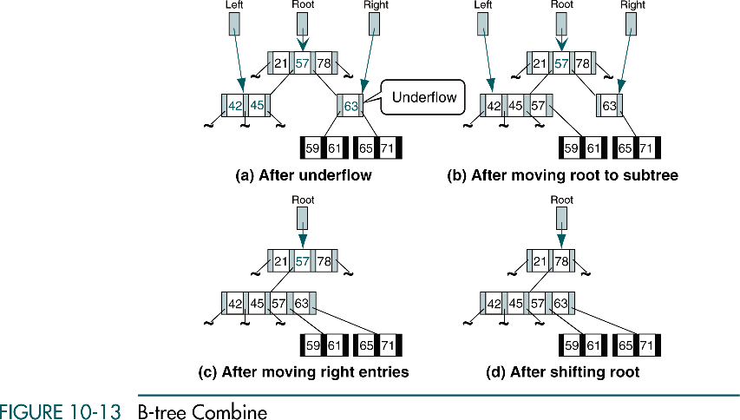

Slide 39
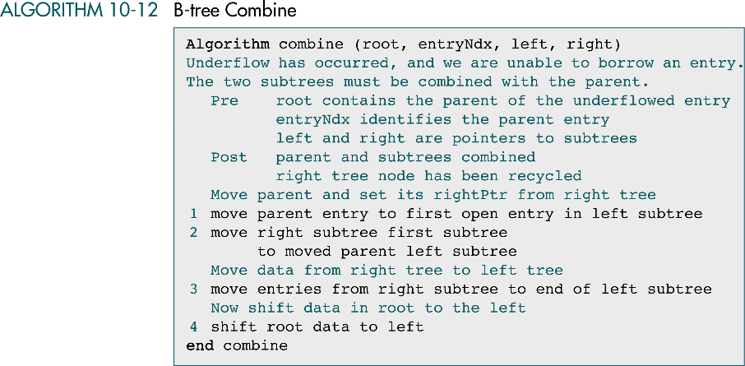
right subtree

Slide 40
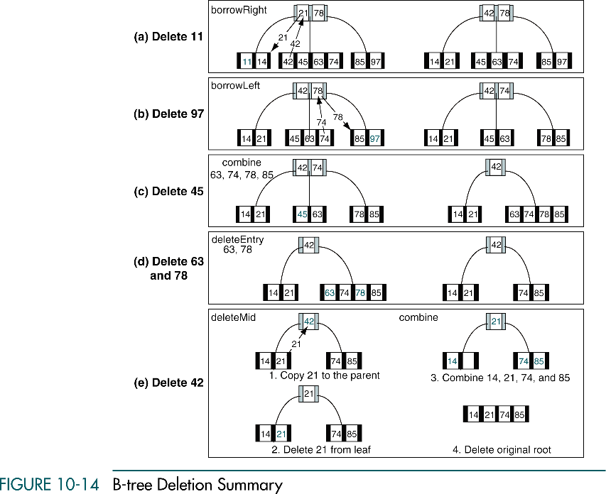

Slide 41
(continued)

Slide 42
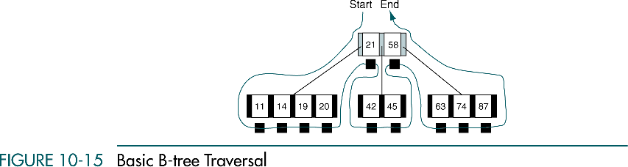
B-tree Traverse
Inorder traversal

Slide 43
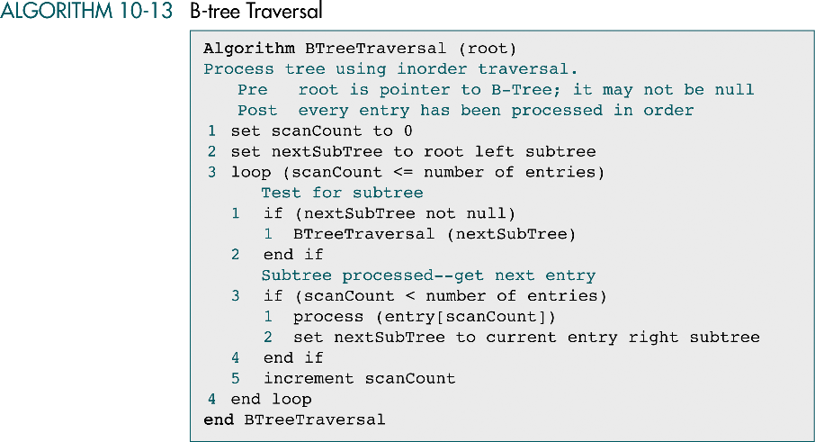

Slide 44
B-tree Search
Binary search tree
Simply returning the node that contained the target data
B-tree
Returning the node is not sufficient because there are multiple entries in a node
We must also return the entry that contains the target

Slide 45
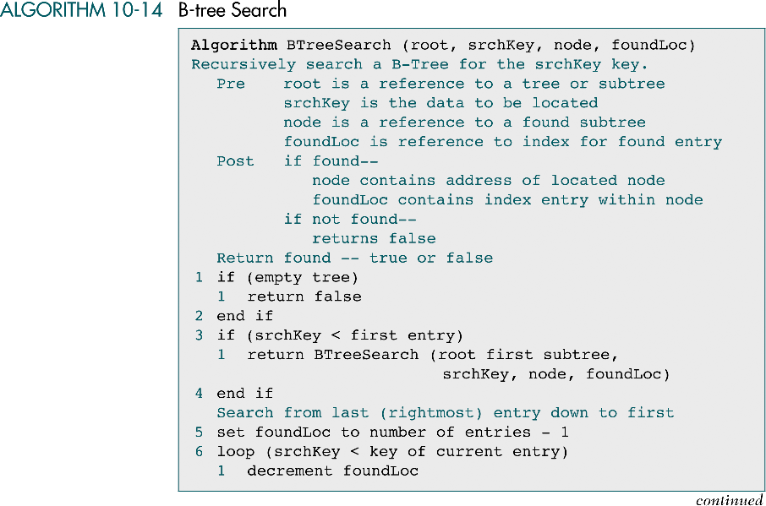

Slide 46
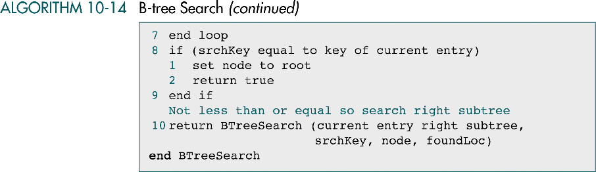

Slide 47
2-3 Tree
Simplified B-trees
2-3 tree
a B-tree of order 3
Each nonroot node has either two or three subtrees
The root may have zero, two, or three subtrees

Slide 48
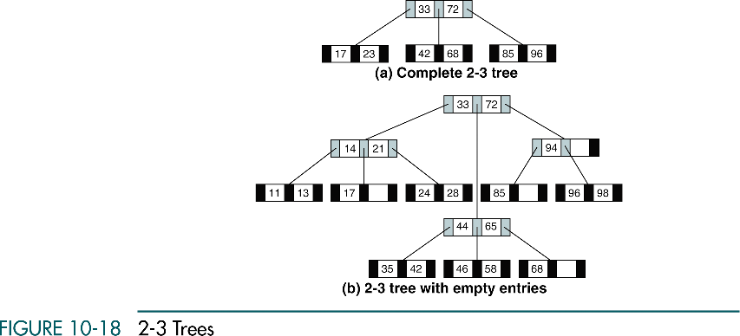
Simplified B-trees

Slide 49
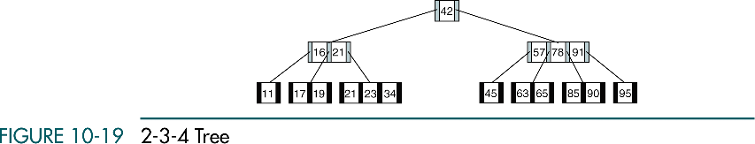
2-3-4 Tree
Simplified B-trees
2-3-4 tree
A B-tree of order 4
Each node can have two, three, or four subtrees

Slide 50
B*tree
B-tree Variations
B-tree
When we use a B-tree to store a large number of entries, the space requirements can become excessive because up to 50% of the entries can be empty
B*tree
When a node overflows, instead of being split immediately, the data are redistributed among the node’s siblings, delaying the creation of a new node
Splitting occurs only when all of the siblings are full
When the nodes are split, data from two full siblings are divided among the two full nodes and a new node, with the result that all three nodes are two-thirds full

Slide 51
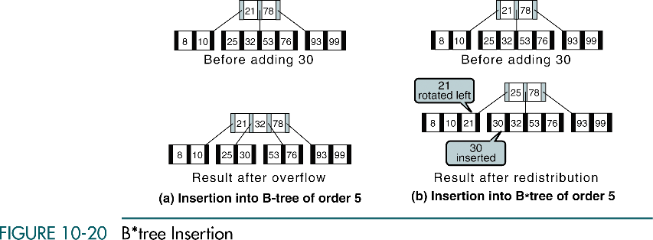
B-tree Variations

Slide 52
B+tree
B-tree Variations
In large file systems,
Data need to be processed both randomly and sequentially
B-tree
the most popular file organization methods to process the data randomly
However, much processing time is taken up moving up and down the tree structure when the data need to be processed sequentially
B+tree
There are two differences between the B-tree and the B+tree:
Each data entry must be represented at the leaf level, even though there may be internal nodes with the same key
Each leaf node has one additional pointer, which is used to move to the next leaf node in sequence

Slide 53
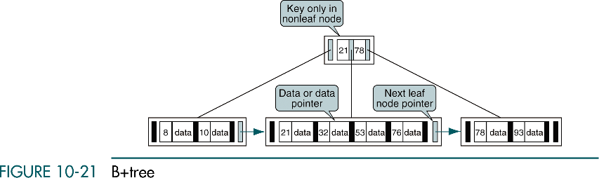
B-tree Variations

Slide 54
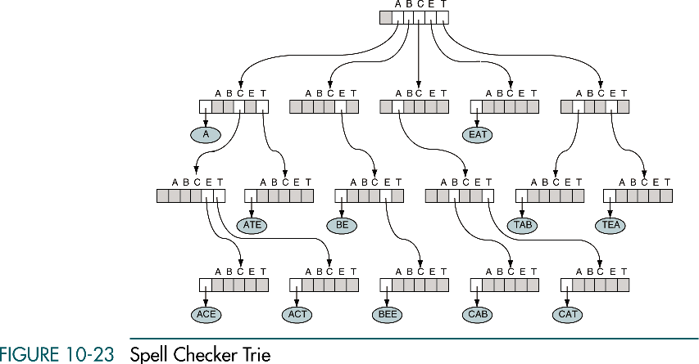
Trie

Slide 55
